Slide 1
Comparison of configuration
Sr.no. | Parameter | CB | CE | CC
1 | Common terminal between input and output

Slide 2
Comparison of configuration
Sr.no. | Parameter | CB | CE | CC
1 | Common terminal between input and output | Base

Slide 3
Comparison of configuration
Sr.no. | Parameter | CB | CE | CC
1 | Common terminal between input and output | Base | Emitter

Slide 4
Comparison of configuration
Sr.no. | Parameter | CB | CE | CC
1 | Common terminal between input and output | Base | Emitter | Collector

Slide 5
Comparison of configuration
Sr.no. | Parameter | CB | CE | CC
1 | Common terminal between input and output | Base | Emitter | Collector
2 | Input current

Slide 6
Comparison of configuration
Sr.no. | Parameter | CB | CE | CC
1 | Common terminal between input and output | Base | Emitter | Collector
2 | Input current | I_{E}

Slide 7
Comparison of configuration
Sr.no. | Parameter | CB | CE | CC
1 | Common terminal between input and output | Base | Emitter | Collector
2 | Input current | I_{E} | I_{B}

Slide 8
Comparison of configuration
Sr.no. | Parameter | CB | CE | CC
1 | Common terminal between input and output | Base | Emitter | Collector
2 | Input current | I_{E} | I_{B} | I_{B}

Slide 9
Comparison of configuration
Sr.no. | Parameter | CB | CE | CC
1 | Common terminal between input and output | Base | Emitter | Collector
2 | Input current | I_{E} | I_{B} | I_{B}
3 | Output current

Slide 10
Comparison of configuration
Sr.no. | Parameter | CB | CE | CC
1 | Common terminal between input and output | Base | Emitter | Collector
2 | Input current | I_{E} | I_{B} | I_{B}
3 | Output current | I_{C}

Slide 11
Comparison of configuration
Sr.no. | Parameter | CB | CE | CC
1 | Common terminal between input and output | Base | Emitter | Collector
2 | Input current | I_{E} | I_{B} | I_{B}
3 | Output current | I_{C} | I_{C}

Slide 12
Comparison of configuration
Sr.no. | Parameter | CB | CE | CC
1 | Common terminal between input and output | Base | Emitter | Collector
2 | Input current | I_{E} | I_{B} | I_{B}
3 | Output current | I_{C} | I_{C} | I_{E}

Slide 13
Comparison of configuration
Sr.no. | Parameter | CB | CE | CC
1 | Common terminal between input and output | Base | Emitter | Collector
2 | Input current | I_{E} | I_{B} | I_{B}
3 | Output current | I_{C} | I_{C} | I_{E}
4 | Current gain

Slide 14
Comparison of configuration
Sr.no. | Parameter | CB | CE | CC
1 | Common terminal between input and output | Base | Emitter | Collector
2 | Input current | I_{E} | I_{B} | I_{B}
3 | Output current | I_{C} | I_{C} | I_{E}
4 | Current gain | α_{DC} = I_{C}/I_{E}

Slide 15
Comparison of configuration
Sr.no. | Parameter | CB | CE | CC
1 | Common terminal between input and output | Base | Emitter | Collector
2 | Input current | I_{E} | I_{B} | I_{B}
3 | Output current | I_{C} | I_{C} | I_{E}
4 | Current gain | α_{DC} = I_{C}/I_{E} | β_{DC} = I_{C}/I_{B}

Slide 16
Comparison of configuration
Sr.no. | Parameter | CB | CE | CC
1 | Common terminal between input and output | Base | Emitter | Collector
2 | Input current | I_{E} | I_{B} | I_{B}
3 | Output current | I_{C} | I_{C} | I_{E}
4 | Current gain | α_{DC} = I_{C}/I_{E} | β_{DC} = I_{C}/I_{B} | γ = I_{E}/I_{B}

Slide 17
Comparison of configuration
Sr.no. | Parameter | CB | CE | CC
1 | Common terminal between input and output | Base | Emitter | Collector
2 | Input current | I_{E} | I_{B} | I_{B}
3 | Output current | I_{C} | I_{C} | I_{E}
4 | Current gain | α_{DC} = I_{C}/I_{E} | β_{DC} = I_{C}/I_{B} | γ = I_{E}/I_{B}
5 | Input Voltage

Slide 18
Comparison of configuration
Sr.no. | Parameter | CB | CE | CC
1 | Common terminal between input and output | Base | Emitter | Collector
2 | Input current | I_{E} | I_{B} | I_{B}
3 | Output current | I_{C} | I_{C} | I_{E}
4 | Current gain | α_{DC} = I_{C}/I_{E} | β_{DC} = I_{C}/I_{B} | γ = I_{E}/I_{B}
5 | Input Voltage | V_{EB}

Slide 19
Comparison of configuration
Sr.no. | Parameter | CB | CE | CC
1 | Common terminal between input and output | Base | Emitter | Collector
2 | Input current | I_{E} | I_{B} | I_{B}
3 | Output current | I_{C} | I_{C} | I_{E}
4 | Current gain | α_{DC} = I_{C}/I_{E} | β_{DC} = I_{C}/I_{B} | γ = I_{E}/I_{B}
5 | Input Voltage | V_{EB} | V_{BE}

Slide 20
Comparison of configuration
Sr.no. | Parameter | CB | CE | CC
1 | Common terminal between input and output | Base | Emitter | Collector
2 | Input current | I_{E} | I_{B} | I_{B}
3 | Output current | I_{C} | I_{C} | I_{E}
4 | Current gain | α_{DC} = I_{C}/I_{E} | β_{DC} = I_{C}/I_{B} | γ = I_{E}/I_{B}
5 | Input Voltage | V_{EB} | V_{BE} | V_{BC}

Slide 21
Comparison of configuration
Sr.no. | Parameter | CB | CE | CC
1 | Common terminal between input and output | Base | Emitter | Collector
2 | Input current | I_{E} | I_{B} | I_{B}
3 | Output current | I_{C} | I_{C} | I_{E}
4 | Current gain | α_{DC} = I_{C}/I_{E} | β_{DC} = I_{C}/I_{B} | γ = I_{E}/I_{B}
5 | Input Voltage | V_{EB} | V_{BE} | V_{BC}
6 | Output voltage

Slide 22
Comparison of configuration
Sr.no. | Parameter | CB | CE | CC
1 | Common terminal between input and output | Base | Emitter | Collector
2 | Input current | I_{E} | I_{B} | I_{B}
3 | Output current | I_{C} | I_{C} | I_{E}
4 | Current gain | α_{DC} = I_{C}/I_{E} | β_{DC} = I_{C}/I_{B} | γ = I_{E}/I_{B}
5 | Input Voltage | V_{EB} | V_{BE} | V_{BC}
6 | Output voltage | V_{CB}

Slide 23
Comparison of configuration
Sr.no. | Parameter | CB | CE | CC
1 | Common terminal between input and output | Base | Emitter | Collector
2 | Input current | I_{E} | I_{B} | I_{B}
3 | Output current | I_{C} | I_{C} | I_{E}
4 | Current gain | α_{DC} = I_{C}/I_{E} | β_{DC} = I_{C}/I_{B} | γ = I_{E}/I_{B}
5 | Input Voltage | V_{EB} | V_{BE} | V_{BC}
6 | Output voltage | V_{CB} | V_{CE}

Slide 24
Comparison of configuration
Sr.no. | Parameter | CB | CE | CC
1 | Common terminal between input and output | Base | Emitter | Collector
2 | Input current | I_{E} | I_{B} | I_{B}
3 | Output current | I_{C} | I_{C} | I_{E}
4 | Current gain | α_{DC} = I_{C}/I_{E} | β_{DC} = I_{C}/I_{B} | γ = I_{E}/I_{B}
5 | Input Voltage | V_{EB} | V_{BE} | V_{BC}
6 | Output voltage | V_{CB} | V_{CE} | V_{EC}

Slide 25
Comparison of configuration
Sr.no. | Parameter | CB | CE | CC
1 | Common terminal between input and output | Base | Emitter | Collector
2 | Input current | I_{E} | I_{B} | I_{B}
3 | Output current | I_{C} | I_{C} | I_{E}
4 | Current gain | α_{DC} = I_{C}/I_{E} | β_{DC} = I_{C}/I_{B} | γ = I_{E}/I_{B}
5 | Input Voltage | V_{EB} | V_{BE} | V_{BC}
6 | Output voltage | V_{CB} | V_{CE} | V_{EC}
7 | Current gain

Slide 26
Comparison of configuration
Sr.no. | Parameter | CB | CE | CC
1 | Common terminal between input and output | Base | Emitter | Collector
2 | Input current | I_{E} | I_{B} | I_{B}
3 | Output current | I_{C} | I_{C} | I_{E}
4 | Current gain | α_{DC} = I_{C}/I_{E} | β_{DC} = I_{C}/I_{B} | γ = I_{E}/I_{B}
5 | Input Voltage | V_{EB} | V_{BE} | V_{BC}
6 | Output voltage | V_{CB} | V_{CE} | V_{EC}
7 | Current gain | Less than unity

Slide 27
Comparison of configuration
Sr.no. | Parameter | CB | CE | CC
1 | Common terminal between input and output | Base | Emitter | Collector
2 | Input current | I_{E} | I_{B} | I_{B}
3 | Output current | I_{C} | I_{C} | I_{E}
4 | Current gain | α_{DC} = I_{C}/I_{E} | β_{DC} = I_{C}/I_{B} | γ = I_{E}/I_{B}
5 | Input Voltage | V_{EB} | V_{BE} | V_{BC}
6 | Output voltage | V_{CB} | V_{CE} | V_{EC}
7 | Current gain | Less than unity | high

Slide 28
Comparison of configuration
Sr.no. | Parameter | CB | CE | CC
1 | Common terminal between input and output | Base | Emitter | Collector
2 | Input current | I_{E} | I_{B} | I_{B}
3 | Output current | I_{C} | I_{C} | I_{E}
4 | Current gain | α_{DC} = I_{C}/I_{E} | β_{DC} = I_{C}/I_{B} | γ = I_{E}/I_{B}
5 | Input Voltage | V_{EB} | V_{BE} | V_{BC}
6 | Output voltage | V_{CB} | V_{CE} | V_{EC}
7 | Current gain | Less than unity | high | high

Slide 29
Comparison of configuration
Sr.no. | Parameter | CB | CE | CC
1 | Common terminal between input and output | Base | Emitter | Collector
2 | Input current | I_{E} | I_{B} | I_{B}
3 | Output current | I_{C} | I_{C} | I_{E}
4 | Current gain | α_{DC} = I_{C}/I_{E} | β_{DC} = I_{C}/I_{B} | γ = I_{E}/I_{B}
5 | Input Voltage | V_{EB} | V_{BE} | V_{BC}
6 | Output voltage | V_{CB} | V_{CE} | V_{EC}
7 | Current gain | Less than unity | high | High
8 | Input resistance

Slide 30
Comparison of configuration
Sr.no. | Parameter | CB | CE | CC
1 | Common terminal between input and output | Base | Emitter | Collector
2 | Input current | I_{E} | I_{B} | I_{B}
3 | Output current | I_{C} | I_{C} | I_{E}
4 | Current gain | α_{DC} = I_{C}/I_{E} | β_{DC} = I_{C}/I_{B} | γ = I_{E}/I_{B}
5 | Input Voltage | V_{EB} | V_{BE} | V_{BC}
6 | Output voltage | V_{CB} | V_{CE} | V_{EC}
7 | Current gain | Less than unity | high | High
8 | Input resistance | Very low (20Ω)

Slide 31
Comparison of configuration
Sr.no. | Parameter | CB | CE | CC
1 | Common terminal between input and output | Base | Emitter | Collector
2 | Input current | I_{E} | I_{B} | I_{B}
3 | Output current | I_{C} | I_{C} | I_{E}
4 | Current gain | α_{DC} = I_{C}/I_{E} | β_{DC} = I_{C}/I_{B} | γ = I_{E}/I_{B}
5 | Input Voltage | V_{EB} | V_{BE} | V_{BC}
6 | Output voltage | V_{CB} | V_{CE} | V_{EC}
7 | Current gain | Less than unity | high | High
8 | Input resistance | Very low (20Ω) | low (1KΩ)

Slide 32
Comparison of configuration
Sr.no. | Parameter | CB | CE | CC
1 | Common terminal between input and output | Base | Emitter | Collector
2 | Input current | I_{E} | I_{B} | I_{B}
3 | Output current | I_{C} | I_{C} | I_{E}
4 | Current gain | α_{DC} = I_{C}/I_{E} | β_{DC} = I_{C}/I_{B} | γ = I_{E}/I_{B}
5 | Input Voltage | V_{EB} | V_{BE} | V_{BC}
6 | Output voltage | V_{CB} | V_{CE} | V_{EC}
7 | Current gain | Less than unity | high | High
8 | Input resistance | Very low (20Ω) | low (1KΩ) | high(500KΩ)

Slide 33
Comparison of configuration
Sr.no. | Parameter | CB | CE | CC
1 | Common terminal between input and output | Base | Emitter | Collector
2 | Input current | I_{E} | I_{B} | I_{B}
3 | Output current | I_{C} | I_{C} | I_{E}
4 | Current gain | α_{DC} = I_{C}/I_{E} | β_{DC} = I_{C}/I_{B} | γ = I_{E}/I_{B}
5 | Input Voltage | V_{EB} | V_{BE} | V_{BC}
6 | Output voltage | V_{CB} | V_{CE} | V_{EC}
7 | Current gain | Less than unity | high | High
8 | Input resistance | Very low (20Ω) | low (1KΩ) | high(500KΩ)
9 | Output resistance

Slide 34
Comparison of configuration
Sr.no. | Parameter | CB | CE | CC
1 | Common terminal between input and output | Base | Emitter | Collector
2 | Input current | I_{E} | I_{B} | I_{B}
3 | Output current | I_{C} | I_{C} | I_{E}
4 | Current gain | α_{DC} = I_{C}/I_{E} | β_{DC} = I_{C}/I_{B} | γ = I_{E}/I_{B}
5 | Input Voltage | V_{EB} | V_{BE} | V_{BC}
6 | Output voltage | V_{CB} | V_{CE} | V_{EC}
7 | Current gain | Less than unity | high | High
8 | Input resistance | Very low (20Ω) | low (1KΩ) | high(500KΩ)
9 | Output resistance | Very high (1M)

Slide 35
Comparison of configuration
Sr.no. | Parameter | CB | CE | CC
1 | Common terminal between input and output | Base | Emitter | Collector
2 | Input current | I_{E} | I_{B} | I_{B}
3 | Output current | I_{C} | I_{C} | I_{E}
4 | Current gain | α_{DC} = I_{C}/I_{E} | β_{DC} = I_{C}/I_{B} | γ = I_{E}/I_{B}
5 | Input Voltage | V_{EB} | V_{BE} | V_{BC}
6 | Output voltage | V_{CB} | V_{CE} | V_{EC}
7 | Current gain | Less than unity | high | High
8 | Input resistance | Very low (20Ω) | low (1KΩ) | high(500KΩ)
9 | Output resistance | Very high (1M) | high(40KΩ)

Slide 36
Comparison of configuration
Sr.no. | Parameter | CB | CE | CC
1 | Common terminal between input and output | Base | Emitter | Collector
2 | Input current | I_{E} | I_{B} | I_{B}
3 | Output current | I_{C} | I_{C} | I_{E}
4 | Current gain | α_{DC} = I_{C}/I_{E} | β_{DC} = I_{C}/I_{B} | γ = I_{E}/I_{B}
5 | Input Voltage | V_{EB} | V_{BE} | V_{BC}
6 | Output voltage | V_{CB} | V_{CE} | V_{EC}
7 | Current gain | Less than unity | high | High
8 | Input resistance | Very low (20Ω) | low (1KΩ) | high(500KΩ)
9 | Output resistance | Very high (1M) | high(40KΩ) | low (50Ω)

Slide 37
Comparison of configuration
Sr.no. | Parameter | CB | CE | CC
1 | Common terminal between input and output | Base | Emitter | Collector
2 | Input current | I_{E} | I_{B} | I_{B}
3 | Output current | I_{C} | I_{C} | I_{E}
4 | Current gain | α_{DC} = I_{C}/I_{E} | β_{DC} = I_{C}/I_{B} | γ = I_{E}/I_{B}
5 | Input Voltage | V_{EB} | V_{BE} | V_{BC}
6 | Output voltage | V_{CB} | V_{CE} | V_{EC}
7 | Current gain | Less than unity | high | High
8 | Input resistance | Very low (20Ω) | low (1KΩ) | high(500KΩ)
9 | Output resistance | Very high (1M) | high(40KΩ) | low (50Ω)
10 | Application

Slide 38
Comparison of configuration
Sr.no. | Parameter | CB | CE | CC
1 | Common terminal between input and output | Base | Emitter | Collector
2 | Input current | I_{E} | I_{B} | I_{B}
3 | Output current | I_{C} | I_{C} | I_{E}
4 | Current gain | α_{DC} = I_{C}/I_{E} | β_{DC} = I_{C}/I_{B} | γ = I_{E}/I_{B}
5 | Input Voltage | V_{EB} | V_{BE} | V_{BC}
6 | Output voltage | V_{CB} | V_{CE} | V_{EC}
7 | Current gain | Less than unity | high | High
8 | Input resistance | Very low (20Ω) | low (1KΩ) | high(500KΩ)
9 | Output resistance | Very high (1M) | high(40KΩ) | low (50Ω)
10 | Application | As preamplifier

Slide 39
Comparison of configuration
Sr.no. | Parameter | CB | CE | CC
1 | Common terminal between input and output | Base | Emitter | Collector
2 | Input current | I_{E} | I_{B} | I_{B}
3 | Output current | I_{C} | I_{C} | I_{E}
4 | Current gain | α_{DC} = I_{C}/I_{E} | β_{DC} = I_{C}/I_{B} | γ = I_{E}/I_{B}
5 | Input Voltage | V_{EB} | V_{BE} | V_{BC}
6 | Output voltage | V_{CB} | V_{CE} | V_{EC}
7 | Current gain | Less than unity | high | High
8 | Input resistance | Very low (20Ω) | low (1KΩ) | high(500KΩ)
9 | Output resistance | Very high (1M) | high(40KΩ) | low (50Ω)
10 | Application | As preamplifier | Audio amplifier

Slide 40
Comparison of configuration
Sr.no. | Parameter | CB | CE | CC
1 | Common terminal between input and output | Base | Emitter | Collector
2 | Input current | I_{E} | I_{B} | I_{B}
3 | Output current | I_{C} | I_{C} | I_{E}
4 | Current gain | α_{DC} = I_{C}/I_{E} | β_{DC} = I_{C}/I_{B} | γ = I_{E}/I_{B}
5 | Input Voltage | V_{EB} | V_{BE} | V_{BC}
6 | Output voltage | V_{CB} | V_{CE} | V_{EC}
7 | Current gain | Less than unity | high | High
8 | Input resistance | Very low (20Ω) | low (1KΩ) | high(500KΩ)
9 | Output resistance | Very high (1M) | high(40KΩ) | low (50Ω)
10 | Application | As preamplifier | Audio amplifier | impedance matching

Slide 41
Why is CE configuration most preferred configuration ?
Out of three configurations, the CE configuration is the most popular and widely used configurations. The reasons are as follows :

Slide 42
Why is CE configuration most preferred configuration ?
Out of three configurations, the CE configuration is the most popular and widely used configurations. The reasons are as follows :
It has high voltage gain as well as a high current gain.

Slide 43
Why is CE configuration most preferred configuration ?
Out of three configurations, the CE configuration is the most popular and widely used configurations. The reasons are as follows :
It has high voltage gain as well as a high current gain.
As voltage gain and current gain are high, it has very high power gain.

Slide 44
Why is CE configuration most preferred configuration ?
Out of three configurations, the CE configuration is the most popular and widely used configurations. The reasons are as follows :
It has high voltage gain as well as a high current gain.
As voltage gain and current gain are high, it has very high power gain.
The CE configuration has moderate values of Ri and Ro, therefore many such stages can be coupled to each other without using any additional impedance matching circuit.

Slide 45
Transistor Biasing
What is meant by dc biasing of a transistor ?
Depending on the application, a transistor is to be operated in any of the three regions of operation namely cutoff, active and saturation region.
To operate the transistor in these regions the two junctions of a transistor should be forward or reverse bias

Slide 46
Transistor biasing
Sr.No. | Region of operation | Base emitter junction | Collector base junction | application
1 | Cutoff region | Reverse biased | Reverse biased
2 | Saturation region | Forward biased | Forward biased
3 | Active region | Forward biased | Reverse biased | Amplifier
In order to do so, we need to connect external dc power supplies with correct polarities and magnitudes. This process is called as dc biasing of a transistor.

Slide 47
DC Load Line
Procedure to plot the DC load line
C
I_{C}
R_{E}
I_{B}
+
B
V_{BE}
V_{CE}
-
R_{B}
V_{CC}
+
I_{E}
V_{BB}
E
-
N-P-N Transistor

Slide 48
DC Load Line
Procedure to plot the DC load line
Refer to the collector circuit of a CE configuration, apply KVL
C
I_{C}
R_{E}
I_{B}
+
B
V_{BE}
V_{CE}
-
R_{B}
V_{CC}
+
I_{E}
V_{BB}
E
-
N-P-N Transistor

Slide 49
DC Load Line
Procedure to plot the DC load line
Refer to the collector circuit of a CE configuration, apply KVL
V_{CC} – V_{CE} – I_{C}R_{C} = 0
C
I_{C}
R_{C}
+
V_{CE}
-
V_{CC}
E
N-P-N Transistor

Slide 50
DC Load Line
Procedure to plot the DC load line
Refer to the collector circuit of a CE configuration, apply KVL
V_{CC} – V_{CE} – I_{C}R_{C} = 0
Rearranging this equation we get
I_{C} = [-1/R_{C}] V_{CE} + V_{CC}/R_{C}
C
I_{C}
R_{C}
+
V_{CE}
-
V_{CC}
E
N-P-N Transistor

Slide 51
DC Load Line
Procedure to plot the DC load line
Refer to the collector circuit of a CE configuration, apply KVL
V_{CC} – V_{CE} – I_{C}R_{C} = 0
Rearranging this equation we get
I_{C} = [-1/R_{C}] V_{CE} + V_{CC}/R_{C}
Compare this equation with general equation of straight line
i.e. y = mx + C
C
I_{C}
R_{C}
+
V_{CE}
-
V_{CC}
E
N-P-N Transistor

Slide 52
DC Load Line
I_{C} = [-1/R_{C}] V_{CE} + V_{CC}/R_{C}
i.e. y = mx + C
The comparison yields the following results.
y= I_{C}
C
I_{C}
R_{C}
+
V_{CE}
-
V_{CC}
E
N-P-N Transistor

Slide 53
DC Load Line
I_{C} = [-1/R_{C}] V_{CE} + V_{CC}/R_{C}
i.e. y = mx + C
The comparison yields the following results.
y = I_{C}
m = -1/R_{C}
C
I_{C}
R_{C}
+
V_{CE}
-
V_{CC}
E
N-P-N Transistor

Slide 54
DC Load Line
I_{C} = [-1/R_{C}] V_{CE} + V_{CC}/R_{C}
i.e. y = mx + C
The comparison yields the following results.
Y = I_{C}
m = -1/R_{C}
X = V_{CE}
C
I_{C}
R_{C}
+
V_{CE}
-
V_{CC}
E
N-P-N Transistor

Slide 55
DC Load Line
I_{C} = [-1/R_{C}] V_{CE} + V_{CC}/R_{C}
i.e. y = mx + C
The comparison yields the following results.
y = I_{C}
m = -1/R_{C}
X = V_{CE}
C =V_{CC}/R_{C}
C
I_{C}
R_{C}
+
V_{CE}
-
V_{CC}
E
N-P-N Transistor

Slide 56
DC Load Line
I_{C} = [-1/R_{C}] V_{CE} + V_{CC}/R_{C}
i.e. y = mx + C
The comparison yields the following results.
y = I_{C}
m = -1/R_{C}
X = V_{CE}
C =V_{CC}/R_{C}
This comparison shows that above equation represents a straight line.
This straight line is called as DC load line
C
I_{C}
R_{C}
+
V_{CE}
-
V_{CC}
E
N-P-N Transistor

Slide 57
DC Load Line
I_{C} = [-1/R_{C}] V_{CE} + V_{CC}/R_{C}
Now substitute V_{CE} = 0 in above equation
C
I_{C}
R_{C}
Saturation
region
Active
region
+
I_{C}
(mA)
4
3
2
1
-
I_{B} = 4μA
V_{CE}
V_{CC}
I_{B} = 3μA
I_{B} = 2μA
I_{B} = 0
E
1 2 3 4
N-P-N Transistor
V_{CE}
Cutoff region

Slide 58
DC Load Line
I_{C} = [-1/R_{C}] V_{CE} + V_{CC}/R_{C}
Now substitute V_{CE} = 0 in above equation
I_{C} = V_{CC}/R_{C}
C
I_{C}
R_{C}
Saturation
region
Active
region
+
I_{C}
(mA)
4
3
2
1
-
I_{B} = 4μA
V_{CE}
V_{CC}
I_{B} = 3μA
I_{B} = 2μA
I_{B} = 0
E
1 2 3 4
N-P-N Transistor
V_{CE}
Cutoff region

Slide 59
DC Load Line
I_{C} = [-1/R_{C}] V_{CE} + V_{CC}/R_{C}
Now substitute V_{CE} = 0 in above equation
I_{C} = V_{CC}/R_{C}
Or I_{C(MAX)} = V_{CC}/R_{C} or point “A”
C
I_{C}
R_{C}
Saturation
region
Active
region
I_{C}
(mA)
+
I_{C}
(MAX)
A
3
2
1
-
I_{B} = 4μA
V_{CE}
V_{CC}
I_{B} = 3μA
I_{B} = 2μA
I_{B} = 0
E
1 2 3 4
N-P-N Transistor
V_{CE}
Cutoff region

Slide 60
DC Load Line
I_{C} = [-1/R_{C}] V_{CE} + V_{CC}/R_{C}
and substituting I_{C} = 0 in above equation
C
I_{C}
R_{C}
Saturation
region
Active
region
I_{C}
(mA)
+
I_{C}
(MAX)
A
3
2
1
-
I_{B} = 4μA
V_{CE}
V_{CC}
I_{B} = 3μA
I_{B} = 2μA
I_{B} = 0
E
V_{CE}
N-P-N Transistor
1 2 3 4
Cutoff region

Slide 61
DC Load Line
I_{C} = [-1/R_{C}] V_{CE} + V_{CC}/R_{C}
and substituting I_{C} = 0 in above equation
V_{CE} = V_{CC}
or point “B”
C
I_{C}
R_{C}
Saturation
region
Active
region
I_{C}
(mA)
+
I_{C}
(MAX)
A
3
2
1
-
I_{B} = 4μA
V_{CE}
V_{CC}
I_{B} = 3μA
I_{B} = 2μA
I_{B} = 0
E
V_{CE}
N-P-N Transistor
1 2 3 4
B
Cutoff region
V_{CE}=V_{CC}

Slide 62
DC Load Line
I_{C} = [-1/R_{C}] V_{CE} + V_{CC}/R_{C}
and substituting I_{C} = 0 in above equation
V_{CE} = V_{CC}
or point “B”
C
I_{C}
R_{C}
DC load line
I_{C}
(mA)
+
I_{C}
(MAX)
A
3
2
1
-
I_{B} = 4μA
V_{CE}
V_{CC}
I_{B} = 3μA
I_{B} = 2μA
I_{B} = 0
E
V_{CE}
N-P-N Transistor
1 2 3 4
B
V_{CE}=V_{CC}

Slide 63
The quiescent point (Q Point)
The term quiescent means quite, still or inactive. The Q point is also called as “operating point” or “bias point”.
I_{C}
(mA)
I_{C}
(MAX)
DC load line
A
3
2
1
I_{B} = 4μA
I_{B} = 3μA
I_{CQ}
I_{B} = 2μA
I_{B} = 0
V_{CE}
1 2 3 4
B
V_{CEQ}
V_{CE}=V_{CC}

Slide 64
The quiescent point (Q Point)
The term quiescent means quite, still or inactive. The Q point is also called as “operating point” or “bias point”.
It is a point on a load line which represents the dc current through a transistor (I_{CQ}) and the voltage across it (V_{CEQ}), When no ac signal is applied
I_{C}
(mA)
I_{C}
(MAX)
DC load line
A
3
2
1
I_{B} = 4μA
I_{B} = 3μA
I_{CQ}
I_{B} = 2μA
I_{B} = 0
V_{CE}
1 2 3 4
B
V_{CEQ}
V_{CE}=V_{CC}

Slide 65
The quiescent point (Q Point)
The term quiescent means quite, still or inactive. The Q point is also called as “operating point” or “bias point”.
It is a point on a load line which represents the dc current through a transistor (I_{CQ}) and the voltage across it (V_{CEQ}), When no ac signal is applied.
In short it represents a dc biasing conditions
I_{C}
(mA)
I_{C}
(MAX)
DC load line
A
3
2
1
I_{B} = 4μA
I_{B} = 3μA
I_{CQ}
I_{B} = 2μA
I_{B} = 0
V_{CE}
1 2 3 4
B
V_{CEQ}
V_{CE}=V_{CC}

Slide 66
The quiescent point (Q Point)
The dc load line is a set of infinite number of such operating points and the user or designer can choose any point on the dc load line as the operating point.
I_{C}
(mA)
I_{C}
(MAX)
DC load line
A
3
2
1
I_{B} = 4μA
I_{B} = 3μA
I_{CQ}
I_{B} = 2μA
I_{B} = 0
V_{CE}
1 2 3 4
B
V_{CEQ}
V_{CE}=V_{CC}

Slide 67
The quiescent point (Q Point)
The dc load line is a set of infinite number of such operating points and the user or designer can choose any point on the dc load line as the operating point.
The position of operating point on the load line is dependent on the application of transistor.
I_{C}
(mA)
I_{C}
(MAX)
DC load line
A
3
2
1
I_{B} = 4μA
I_{B} = 3μA
I_{CQ}
I_{B} = 2μA
I_{B} = 0
V_{CE}
1 2 3 4
B
V_{CEQ}
V_{CE}=V_{CC}

Slide 68
The quiescent point (Q Point)
The dc load line is a set of infinite number of such operating points and the user or designer can choose any point on the dc load line as the operating point.
The position of operating point on the load line is dependent on the application of transistor.
If the transistor is being used for “amplification” purpose then the Q point should be at the center of load line.
I_{C}
(mA)
I_{C}
(MAX)
DC load line
A
3
2
1
I_{B} = 4μA
I_{B} = 3μA
I_{CQ}
I_{B} = 2μA
I_{B} = 0
V_{CE}
1 2 3 4
B
V_{CEQ}
V_{CE}=V_{CC}

Slide 69
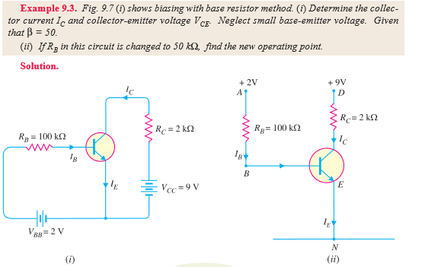
Problems

Slide 70
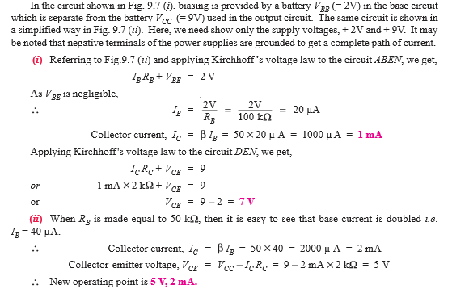

Slide 71
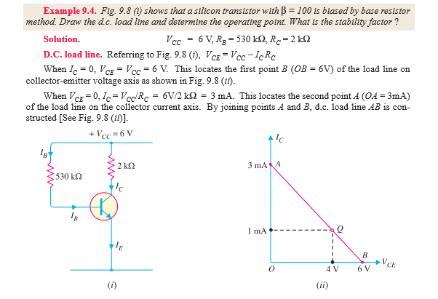
Problem 2

Slide 72
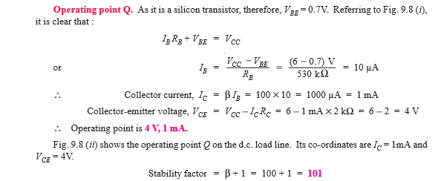

Slide 73
Factor affecting the stability of Q point
After establishing the operating point, when input signal is applied, the output signal should not move the transistor either to saturation or to cut-off. However, this unwanted shift might occur due to various reasons outlined below:

Slide 74
Factor affecting the stability of Q point
After establishing the operating point, when input signal is applied, the output signal should not move the transistor either to saturation or to cut-off. However, this unwanted shift might occur due to various reasons outlined below:
Parameters of transistor depend on temperature. As it increases, leakage current due to minority charge carriers (I_{CBO}) increases. As I_{CBO} increases, I_{CEO} also increases, causing increase in collector current I_{C}. This produces heat at the collector junction. This process repeat, and finally Q-point may shift into saturation region. Sometimes the excess heat produced at the junction may even burn the transistor. This is known as thermal runaway.

Slide 75
Factor affecting the stability of Q point
After establishing the operating point, when input signal is applied, the output signal should not move the transistor either to saturation or to cut-off. However, this unwanted shift might occur due to various reasons outlined below:
Parameters of transistor depend on temperature. As it increases, leakage current due to minority charge carriers (I_{CBO}) increases. As I_{CBO} increases, I_{CEO} also increases, causing increase in collector current I_{C}. This produces heat at the collector junction. This process repeat, and finally Q-point may shift into saturation region. Sometimes the excess heat produced at the junction may even burn the transistor. This is known as thermal runaway.
When a transistor is replaced by another of the same type, the Q-point may shift, due to change in parameters of transistor such as current gain (β) which changes from unit to unit.

Slide 76
Factor affecting the stability of Q point
After establishing the operating point, when input signal is applied, the output signal should not move the transistor either to saturation or to cut-off. However, this unwanted shift might occur due to various reasons outlined below:
Parameters of transistor depend on temperature. As it increases, leakage current due to minority charge carriers (I_{CBO}) increases. As I_{CBO} increases, I_{CEO} also increases, causing increase in collector current I_{C}. This produces heat at the collector junction. This process repeat, and finally Q-point may shift into saturation region. Sometimes the excess heat produced at the junction may even burn the transistor. This is known as thermal runaway.
When a transistor is replaced by another of the same type, the Q-point may shift, due to change in parameters of transistor such as current gain (β) which changes from unit to unit.
To avoid a shift of Q-point, bias-stabilization is necessary. Various biasing circuits can be used for this purpose.

Slide 77
Biasing circuits
To avoid a shift of Q-point, bias-stabilization is necessary. Various biasing circuits can be used for this purpose.
Fixed bias
Collector-to-base bias
Fixed bias with emitter resistor
Voltage divider bias
Emitter bias

Slide 78
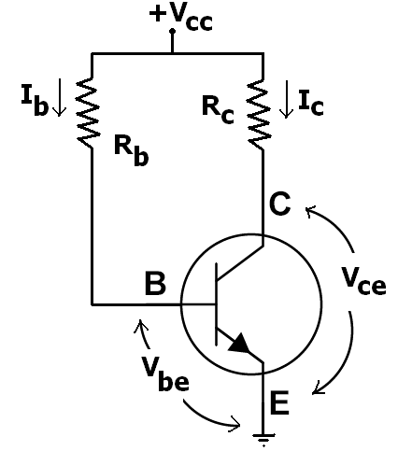
Biasing circuits
Fixed bias
This form of biasing is also called base bias. In the example image on the right, the single power source (for example, a battery) is used for both collector and base of transistor, although separate batteries can also be used.
In the given circuit,
V_{CC} = I_{B}R_{B} + V_{BE}
Therefore,
I_{B} = (V_{CC} - V_{BE})/R_{B}

Slide 79
Biasing circuits
Fixed bias
For a given transistor, V_{BE} does not vary significantly during use. As V_{CC} is of fixed value, on selection of R_{B}, the base current I_{B} is fixed. Therefore this type is called fixed bias type of circuit.
Also for given circuit,
V_{CC} = I_{C}R_{C} + V_{CE}
Therefore,
V_{CE} = V_{CC} - I_{C}R_{C}
From this equation we can obtain V_{CE}. Since I_{C} = βI_{B}, we can obtain I_{C} as well. In this manner, operating point given as (V_{CE},I_{C}) can be set for given transistor.

Slide 80
Biasing circuits
Fixed bias
Merits:
It is simple to shift the operating point anywhere in the active region by merely changing the base resistor (R_{B}).
Very few number of components are required.

Slide 81
Biasing circuits
Fixed bias
Demerits:
The collector current does not remain constant with variation in temperature or power supply voltage. Therefore the operating point is unstable.
When the transistor is replaced with another one, considerable change in the value of β can be expected. Due to this change the operating point will shift.

Slide 82
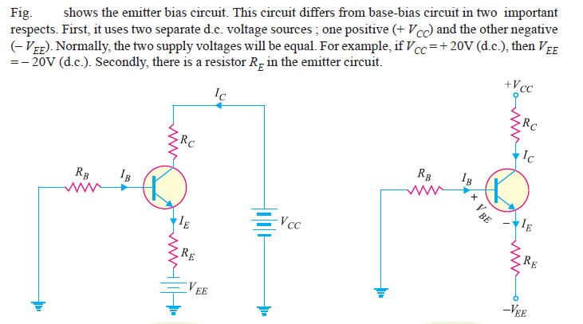
Emitter Bias

Slide 83
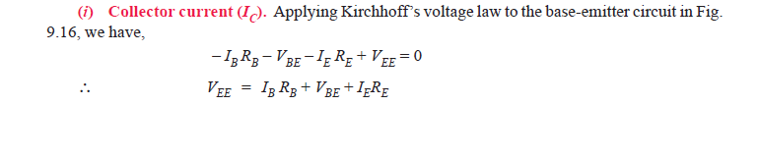

Slide 84
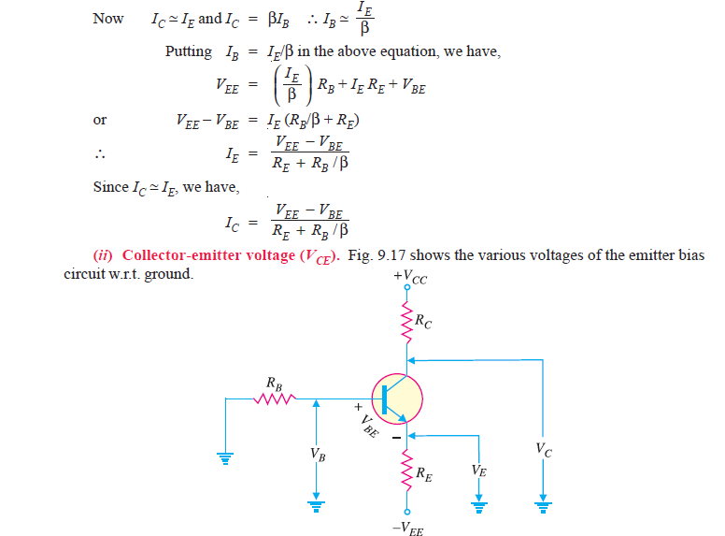

Slide 85
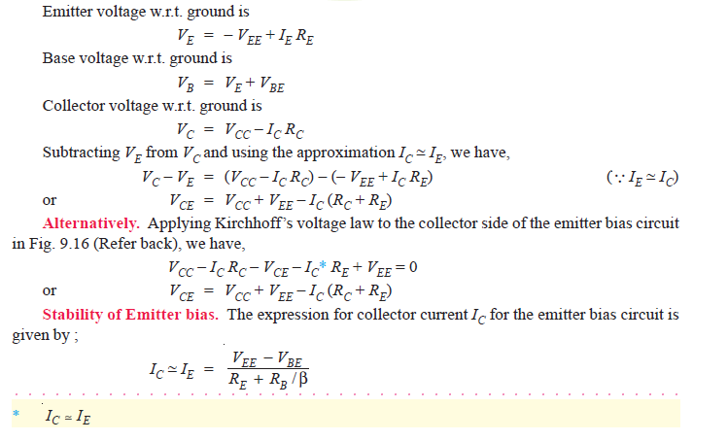

Slide 86
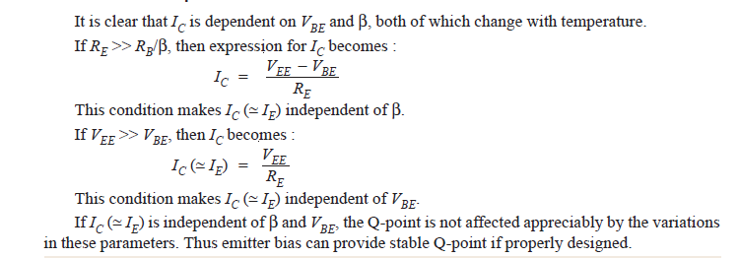

Slide 87
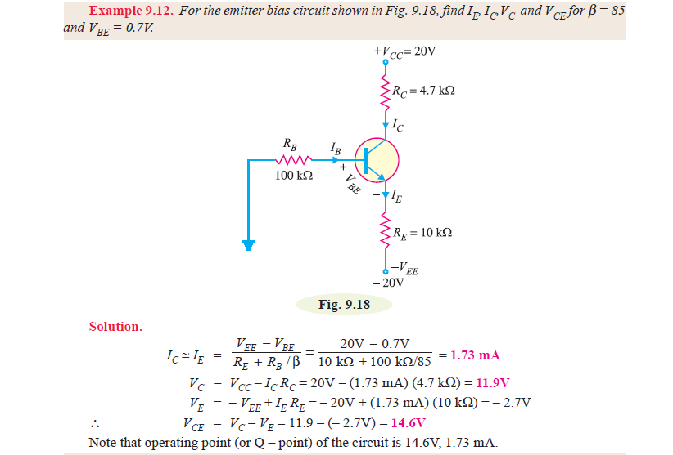

Slide 88
